Slide 1

Regression Analysis
This work is supported by the National Science Foundation under Award 2021287
Difficulty level: Introductory
Notes:
Initial release, Xumin Liu, Rochester Institute of Technology, 2022.
By Xumin Liu https://www.cs.rit.edu/~xl/
Except where otherwise noted, this work is licensed under a Creative Commons Attribution-4.0 International License https://creativecommons.org/licenses/by/4.0/

Slide 2
Contents
Introduction to Regression
Model Quality
Metrics
Notes:
In this lecture, we use Advertising dataset: https://www.kaggle.com/ashydv/advertising-dataset
Please contact Xumin Liu (xmlics@rit.edu) for the code used in the slides.

Slide 3
Introduction to Regression

Slide 4
Regression
Wiki: regression analysis is to estimate the relationships between a dependent variable, i.e., target, and one or more independent variables, i.e., features
Y: continuous value
Common model:
Linear regression – the simplest regression model
Notes:
Regression is a supervised learning. The outcome is a function f() that takes X, i.e., features, as the input and compute the Y’s value. Different from classification, in regression, Y’s value is continuous.
The most commonly used model for regression is linear regression. It is also the simplest regression model as the generated function is a linear equation.

Slide 5
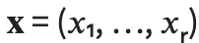
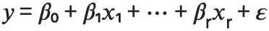
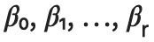
Linear Regression
Find a linear relationship between y and
Linear regression calculates the estimators of the regression coefficients
: regression coefficients
: random error
Notes:
x1,…, xr are the features of a data objects. beta_0 is the intercept, beta_1, … beta_r are the coefficients for the features, epsilon is the random error, which is usually modeled as a zero-mean Gaussian distribution.
During the regression learning, the values of the intercept and the coefficients are learned as a optimization problem so that the learned model fits the data the best.

Slide 6
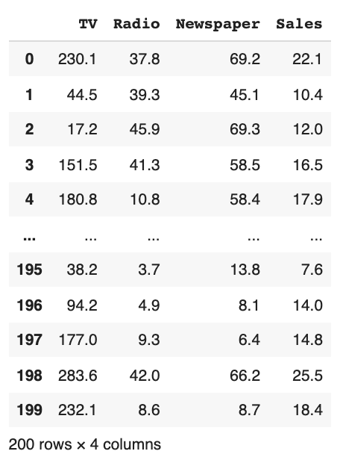
An Example
target
Advertising dataset
Notes:
In this dataset, ’Sales’ is the targeted variable. Using regression, we can generate a model that use one or more other features to predict the ‘Sales’ values.

Slide 7
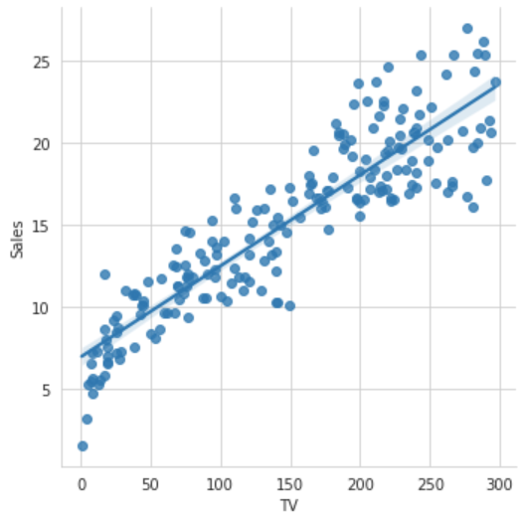
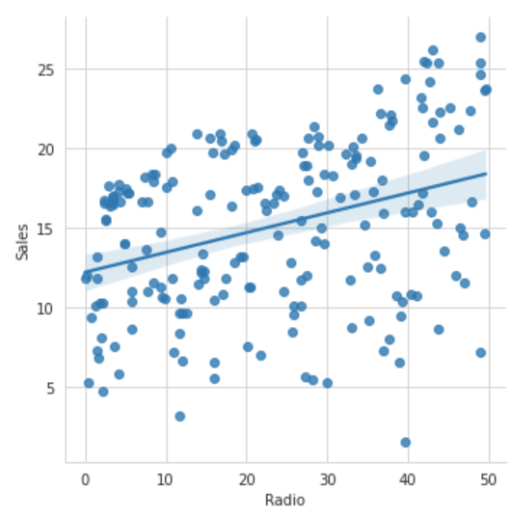
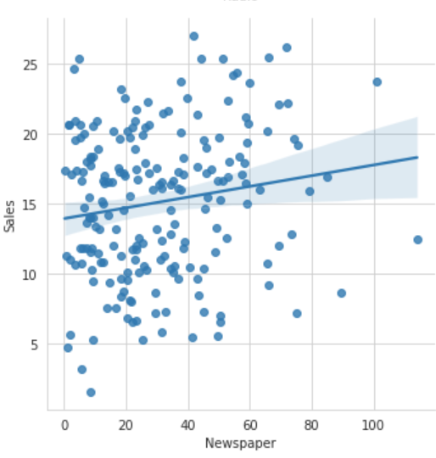
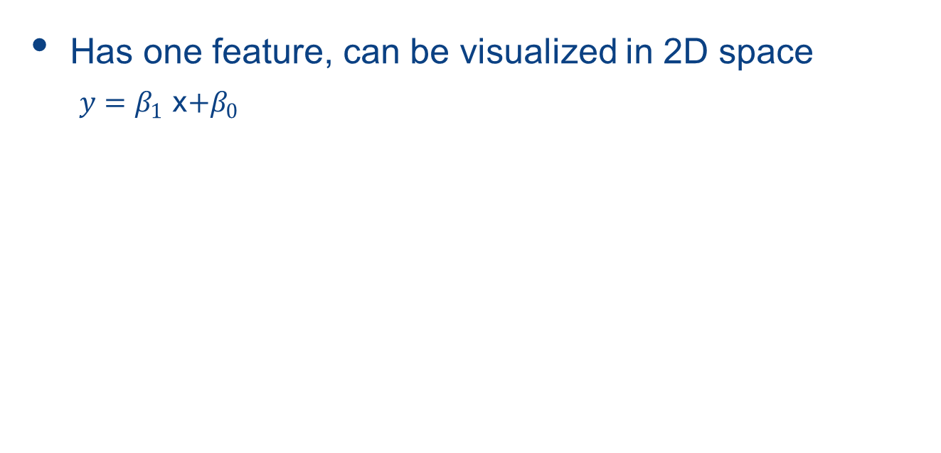
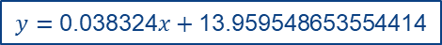
Bivariate Linear Regression
Has one feature, can be visualized in 2D space
$y=β_{1}$ x$+β_{0}$
$$y=\text{0.05546477}x+\text{6.974821488229891}$$
$$y=\text{0.12443166}x+\text{12.235721966369235}$$
$$y=\text{0.038324}x+\text{13.959548653554414}$$
Notes:
Bivariate Linear regression is a linear equation where only one feature is included. In the three figures, we plot the Sales vs TV, Sales vs Radio, Sales vs Newspaper, and the corresponding linear models separately. The plots show that Sales has the highest correlation with TV, the lowest correlation with Newspaper. The first model fits the data the best as the data points are closer to the line compared to the other two models.

Slide 8
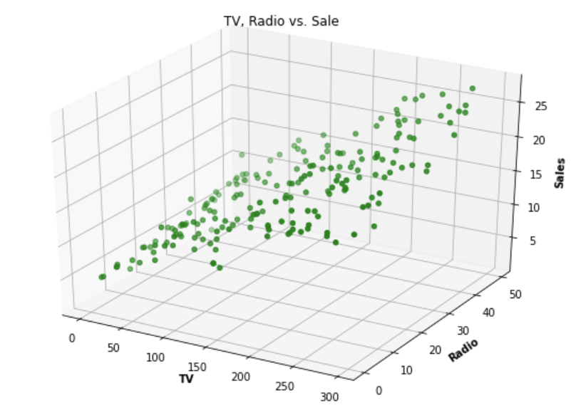
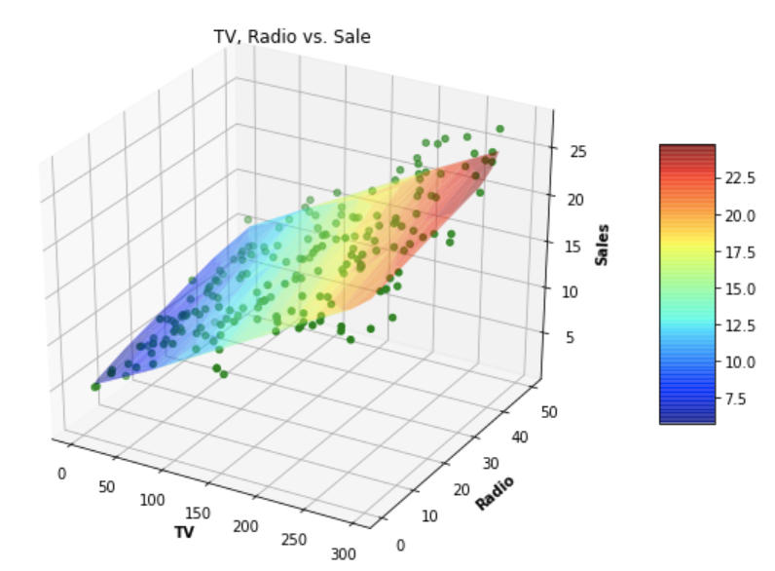
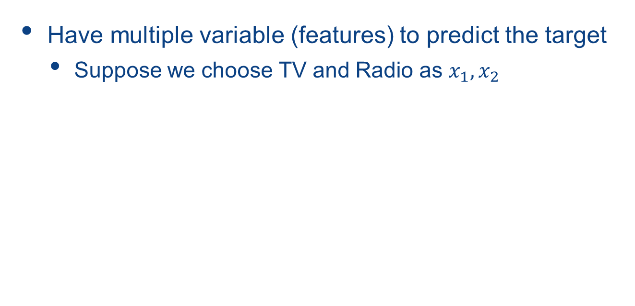
Multiple Linear Regression
Have multiple variable (features) to predict the target
Suppose we choose TV and Radio as $x_{1}, x_{2}$
$$y=\text{0.05444896}x_{1}+\text{0.10717457}x_{2}+\text{4.630879464097768}$$
Notes:
Multiple linear regression is to include more than one features in the model. The figures show the plot of the data points and the learned model in a 3D space.

Slide 9
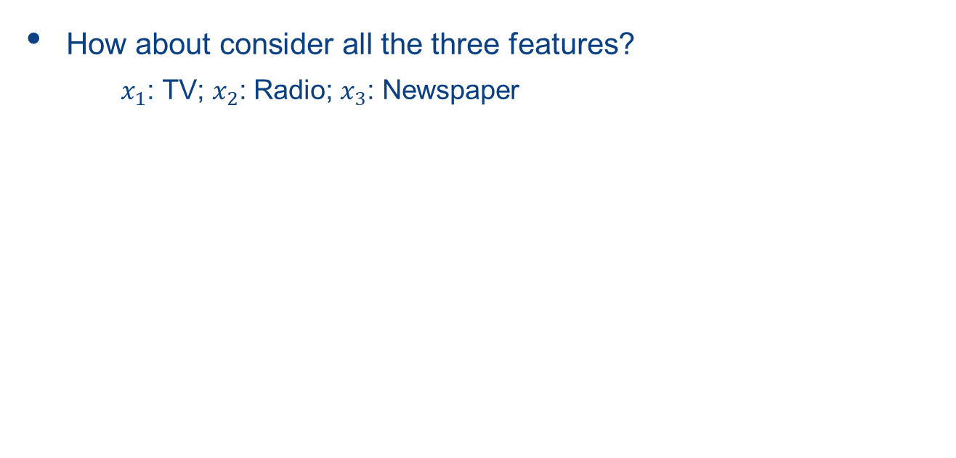
Multiple Linear Regression
How about consider all the three features?
$x_{1}$: TV; $x_{2}$: Radio; $x_{3}$: Newspaper
$$y=\text{0.05444578}x_{1}+\text{0.10700123}x_{2}+\text{0.00033566}x_{2}+\text{4.625124078808653}$$

Slide 10
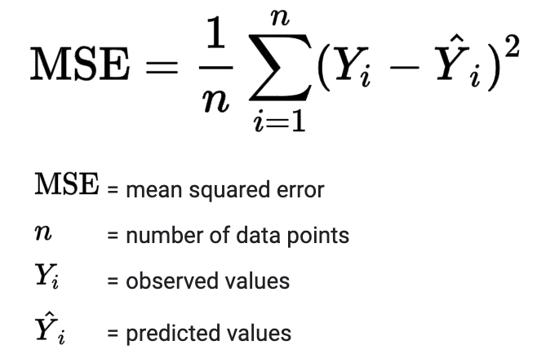
How To Generate the Model
Gradient descent:
Randomly initialize the parameters (i.e., coefficients and intercept)
Update the parameters to minimize the loss function
Repeat Step 2 until converges
Loss function:
Notes:
The model is usually learned through gradient descent, which gives the direction of each step optimization. The parameters including the coefficients and intercept are randomly initialized. For a data record in the training set, the algorithm compute the gradient of the loss function on each parameter with the values of X, Y, and the current values of other parameters, to update its value to make the descent value 0, i.e., to minimize the loss function.
The loss function is defined as mean squared error. By minimize MSE, we can get the model that fits the data in the training set the best.

Slide 11
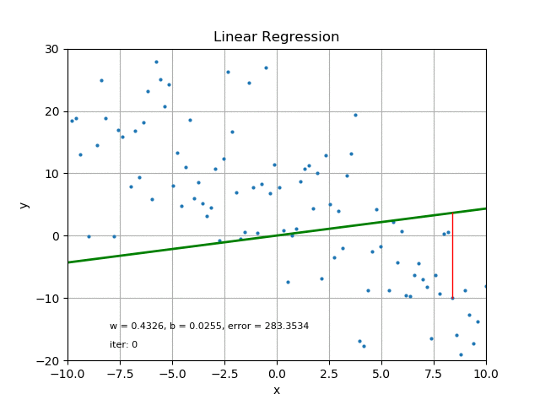
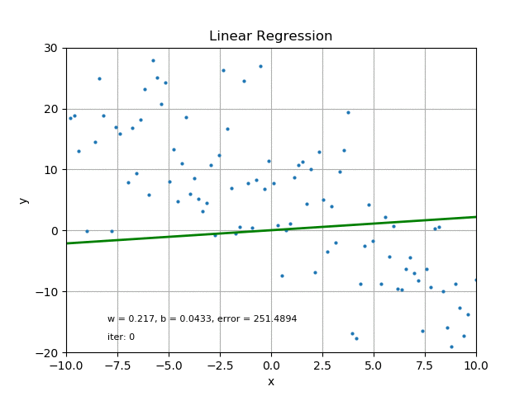
Optimization through gradient descent
Stochastic gradient descent for 2D linear regression
Batch gradient descent
https://medium.com/swlh/from-animation-to-intuition-linear-regression-and-logistic-regression-f641a31e1caf
Notes:
The left figure shows stochastic gradient descent process where only one data point is used in each iteration to compute the gradient. The right figure shows batch gradient descent where a batch of data points are used in each iteration to compute the gradient.

Slide 12
Model Quality

Slide 13
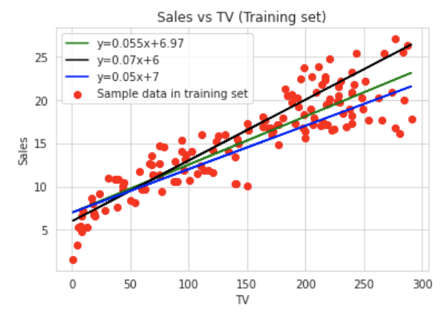

Understand R-squared ($R^{2}$) value
Model is formed by calculating the coefficient(s) and intercept.
Which one is better?
Notes:
Given a set of nodes, we can plot several lines to fit the data, corresponding to several models. We need a measurement to decide which one is better than others.

Slide 14
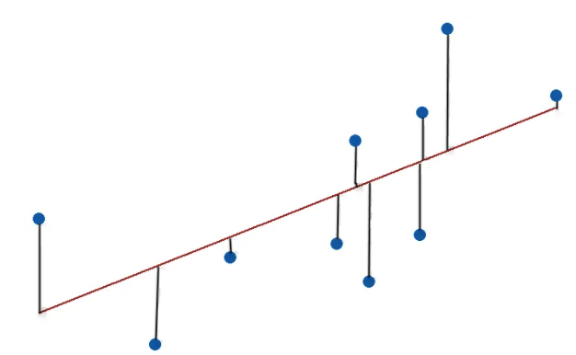
Residuals
The difference between actual values and their predicted values
Find the regression model where residuals are small and unbiased (i.e., random)
Notes:
Residuals refer to the difference between actual values and their predicted values. MSE aims to find the model that has the minimal residuals. We also prefer the model where the residuals are random, i.e., no correlation with the Y’s value.

Slide 15
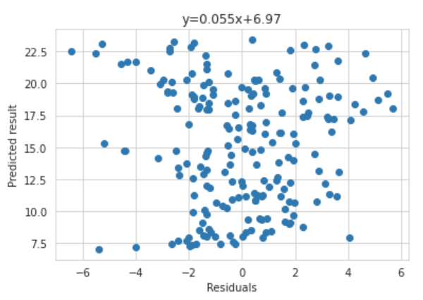
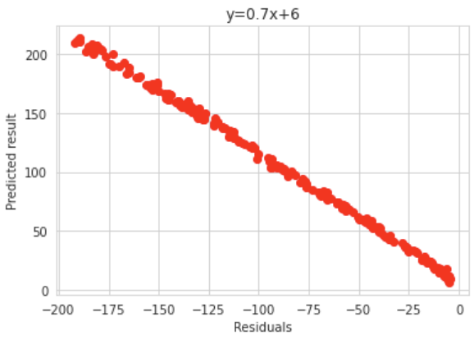
Plot the residuals
Which one is better?
You can’t trust a model that is biased
Notes:
The figures show the residual plots for two linear models. The x axis is the residuals and the y axis is the predicted value. From the plots, you can see that the residuals in the left plot lack patterns and are quite random. But the residuals in the right plot clearly have a negative linear relationship with predicted values.
It is not preferred to have a biased model as the model would favor some input and generate biased result.

Slide 16
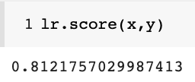
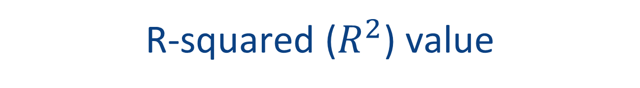
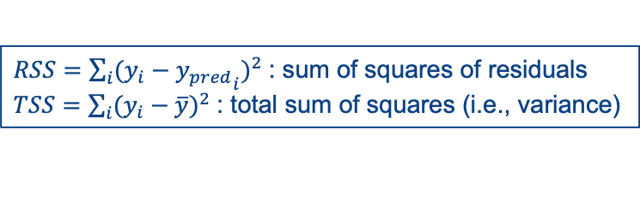
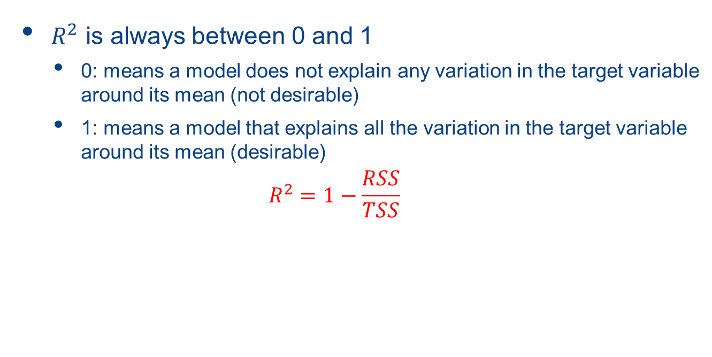
R-squared ($R^{2}$) value
$R^{2}$ is always between 0 and 1
0: means a model does not explain any variation in the target variable around its mean (not desirable)
1: means a model that explains all the variation in the target variable around its mean (desirable)
$$R^{2}=1−\frac{RSS}{TSS}$$
$RSS=\sum_{i}{{(y_{i}−{y_{pred}}_{i})}^{2}}$: sum of squares of residuals
$TSS=\sum_{i}{{(y_{i}−\overline{y})}^{2}}$: total sum of squares (i.e., variance)
Notes:
R2 is a measure for the quality of a regression model. The value ranges from 0 to 1 where 0 indicates that the model cannot explain how y’s value changes with x’s value change. We wouldn’t want a model like this. 1 indicates that the model can explain all the change of y values from the change of x values. So overall we would prefer the model with a higher R squared value.

Slide 17
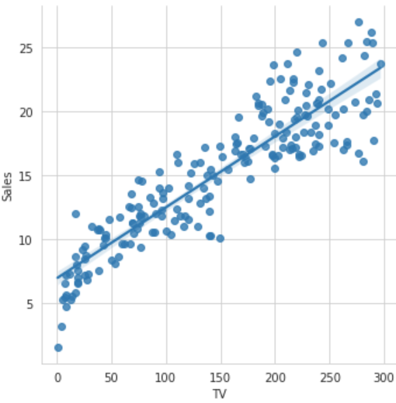
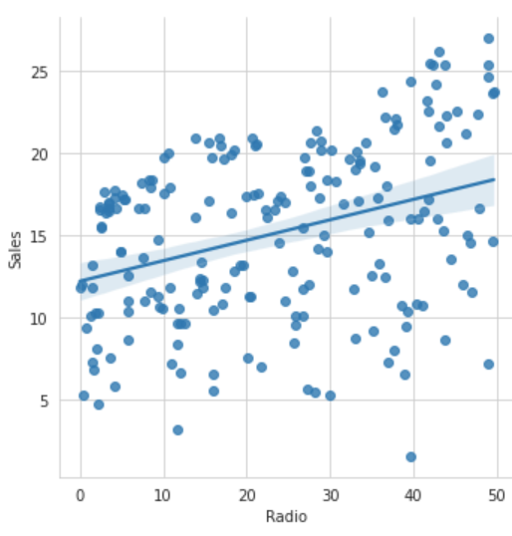
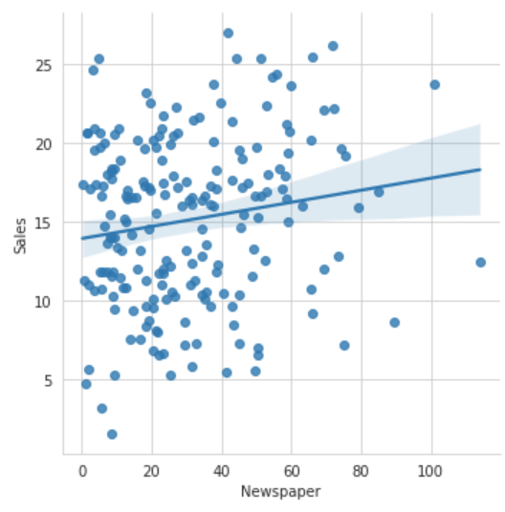
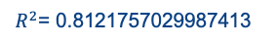

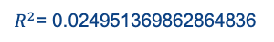
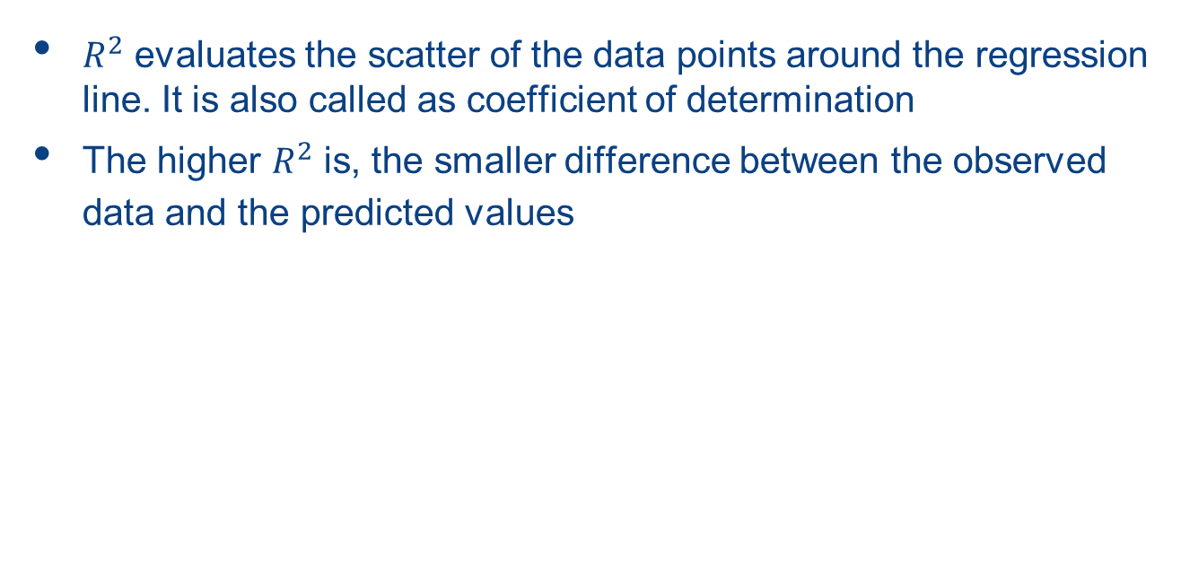
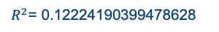
R-squared ($R^{2}$) value
$R^{2}$ evaluates the scatter of the data points around the regression line. It is also called as coefficient of determination
The higher $R^{2}$ is, the smaller difference between the observed data and the predicted values
$R^{2}$= 0.8121757029987413
$R^{2}$= 0.12224190399478628
$R^{2}$= 0.024951369862864836
Notes:
The figures shows the R squared values for three models. The higher R squared value is, the better the model fits the data.

Slide 18
Metrics

Slide 19
Performance Metrics
Evaluate a regression model on testing set
Metrics:
Mean Squared Error (MSE)
Root Mean Squared Error (RMSE)
Mean Absolute Error (MAE)
Notes:
As regression is unsupervised learning, the accuracy of a model is usually tested on a testing set where the data points are not used in the training process.

Slide 20
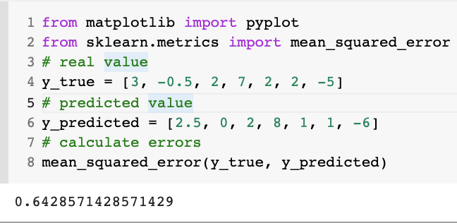
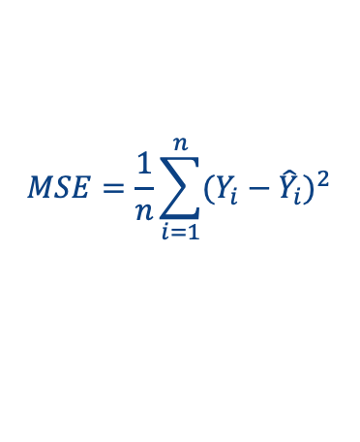

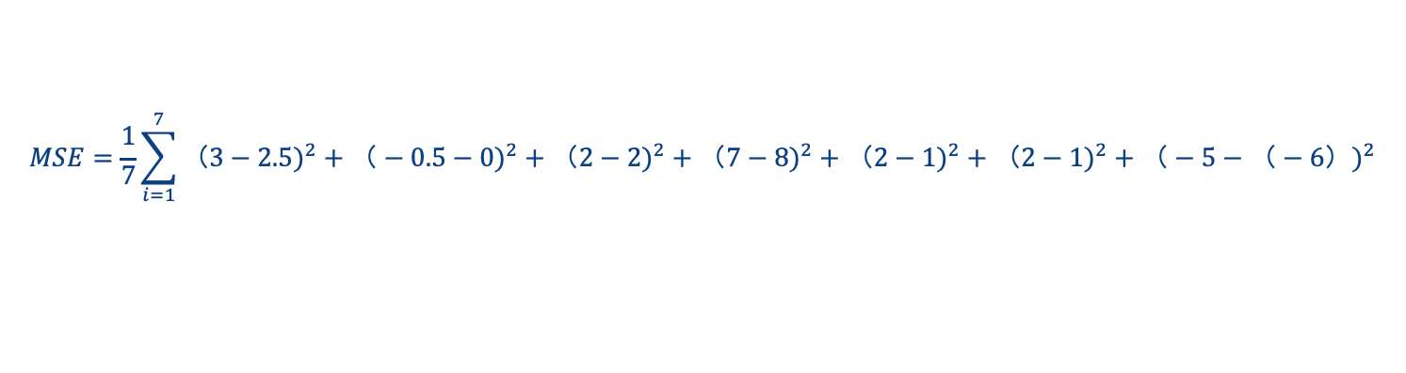
MSE & RMSE
$$MSE=\frac{1}{n}\sum_{i=1}^{n}{{(Y_{i}−{\hat{Y}}_{i})}^{2}}$$
$$RMSE=\sqrt{MSE}$$
i | 1 | 2 | 3 | 4 | 5 | 6 | 7
Predicted | 2.5 | 0 | 2 | 8 | 1 | 1 | -6
True | 3 | -0.5 | 2 | 7 | 2 | 2 | -5
$$MSE=\frac{1}{7}\sum_{i=1}^{7}{{（3−2.5)}^{2}+{（−0.5−0)}^{2}+{（2−2)}^{2}+{（7−8)}^{2}+{（2−1)}^{2}+{（2−1)}^{2}+{（−5−（−6）)}^{2}}$$
Notes:
MSE is computed based on the deviation between predicted and true values of Y. RMSE is the square root of MSE. It has the same unit as Y.

Slide 21
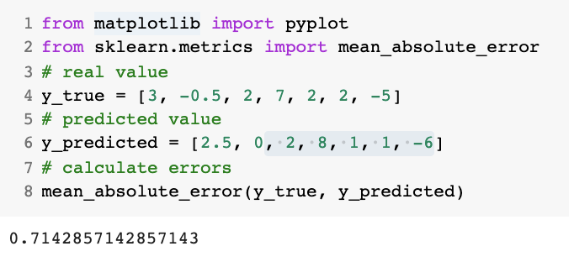
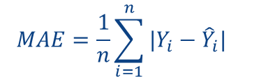
Mean Absolute Error (MAE)
$$MAE=\frac{1}{n}\sum_{i=1}^{n}{{|Y_{i}−{\hat{Y}}_{i}|}^{}}$$
i | 1 | 2 | 3 | 4 | 5 | 6 | 7
Predicted | 2.5 | 0 | 2 | 8 | 1 | 1 | -6
True | 3 | -0.5 | 2 | 7 | 2 | 2 | -5
$$MAE=\frac{1}{7}\sum_{i=1}^{7}{|3−2.5|+|−0.5−0|+|2−2|+|7−8|+|2−1|+|2−1|+|−5−(−6)|}$$
Notes:
MAE considers the absolute difference between the predicted value and the true value for each data record in the testing set.

Slide 22
MSE vs RMSE vs MAE
MSE and RMSE penalize large prediction errors via squared function
RMSE is more commonly used than MSE as it has the same unit as Y
MAE is more robust to outliers
MSE and RMSE are differentiable functions while MAE is not
i.e., its derivative exists for all values
This makes RMSE used as a default metric for loss function in most ML models
The lower the RMSE/MSE is, the better the model is
Scoring function: neg_root_mean_squared_error/neg_mean_squared_error
https://scikit-learn.org/stable/modules/model_evaluation.html
Notes:
RMSE is the default metric for loss function in regression. The lower it is, the more accurate a model is.

Slide 23
Cross validation for Linear Regression
Avoid the performance evaluation being sensitive to the selection of training data
K-fold cross validation
Divide the whole dataset into K partitions
(K-1) partitions for training, 1 partition for testing
Rotate the selection of the testing set
Average the evaluation
Notes:
Cross validation is a standard way to test supervised learning models. It tests a model several times and rotate the selection of testing set.

Slide 24
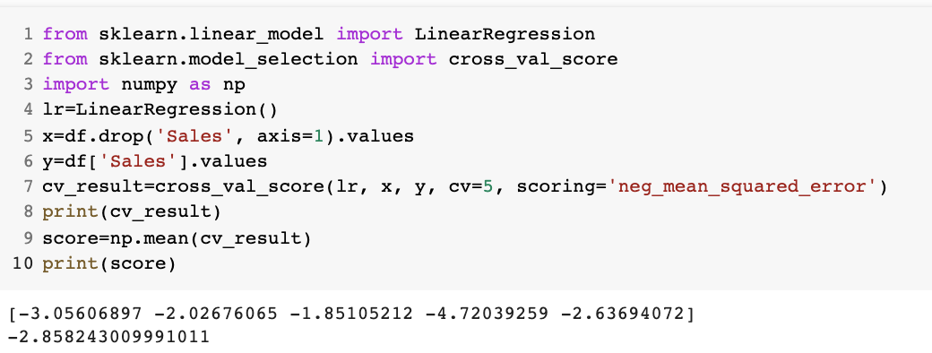
Cross validation for Linear Regression
Notes:
The example shows the 5-fold cross validation and the accuracies of the five tests are printed. The average of those values is used as the overall accuracy of the model.

